Slide 1

Introduction to Hotel Reservation Analysis
Understanding guest preferences, booking trends, and operational insights using SQL and hotel reservation dataset

Slide 2
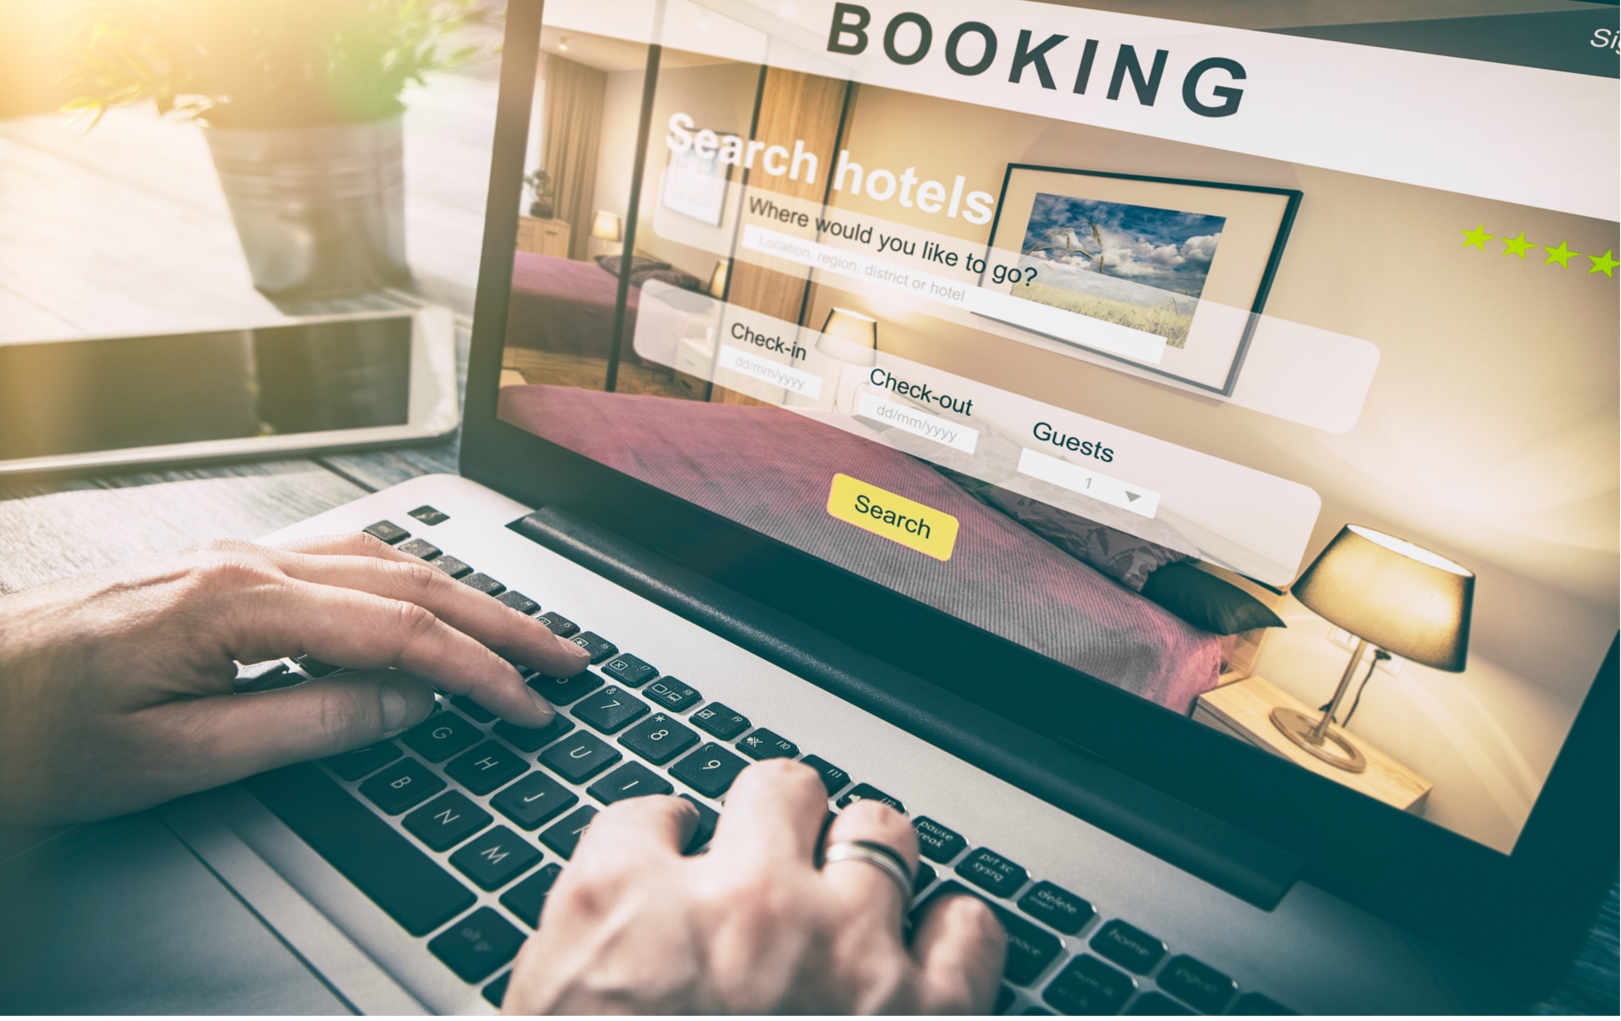
Hotel Data Analysis Project Overview
Ever wondered what guests really want when they book a hotel? That's what we're digging into with this project. Using SQL, we're crunching numbers from our reservation data to find out what makes guests tick and how we can make their stay even better. It's all about making sure our guests leave happy and our hotel keeps thriving.

Slide 3
Hotel Reservation Dataset Overview
Key Columns and Details included in the Hotel Reservation Dataset
Column | Description
Booking_ID | Unique Identifier for each hotel reservation
no_of_adults | Number of adults in the reservation
no_of_children | Number of children in the reservation
no_of_weekend_nights
no_of_week_nights | Number of nights in the reservation on weekdays
type_of_meal_plan | Meal plan chosen by the guest
room_type_reserved | Type of room reserved by the guests
lead_time | Number of days between booking and arrival
arrival_date | Date of arrival
market_segment_type | Market segment to which the reservation belongs
avg_price_per_room | Average price per room in the reservation
booking_status | Status of the booking

Slide 4


QUERY - 1
What is the total number of reservations in the dataset?
SELECT COUNT(Booking_ID) AS Total_Reservation
FROM Hotel_Reservation;
Result
Insights: Understanding the total number of reservations
provides an overview of the dataset's size and the hotel’s
overall booking volume.

Slide 5

QUERY - 2
Which meal plan is the most popular among guests?
SELECT TOP 1 type_of_meal_plan, COUNT(type_of_meal_plan) AS Reservation_Count
FROM Hotel_Reservation
GROUP BY type_of_meal_plan
ORDER BY Reservation_Count DESC;
Result
Insights: Identifying the most popular meal plan among guests helps the hotel understand guest preferences and tailor their offerings accordingly.

Slide 6

QUERY - 3
What is the average price per room for reservations involving children?
SELECT AVG(avg_price_per_room) AS Average_Price_For_Reservations_With_Children
FROM Hotel_Reservation
WHERE no_of_children>0
Result
Insights: Calculating the average price per room for reservations involving children can help the hotel set pricing strategies and package deals for families.

Slide 7

QUERY - 4
How many reservations were made for the year 20XX (replace XX with the desired year)?
SELECT COUNT(Booking_ID) AS Total_Reservations_For_2018
FROM Hotel_Reservation
WHERE YEAR(arrival_date) = '2018';
Result
Insights: Analyzing reservations made for a particular year helps in understanding booking trends over time and aids in forecasting future demand.

Slide 8

QUERY - 5
What is the most commonly booked room type?
SELECT TOP 1 room_type_reserved, COUNT(room_type_reserved) AS Reservation_counts
FROM Hotel_Reservation
GROUP BY room_type_reserved
ORDER BY Reservation_counts DESC;
Result
Insights: Knowing the most commonly booked room type allows the hotel to optimize room allocation and potentially adjust room rates based on demand.

Slide 9

QUERY - 6
How many reservations fall on a weekend (no_of_weekend_nights > 0)?
SELECT COUNT(Booking_ID) AS Total_Weedkend_Reservations
FROM Hotel_Reservation
WHERE no_of_weekend_nights>0;
Result
Insights: Identifying the number of reservations that fall on weekends provides insights into peak booking periods, allowing the hotel to plan staffing and resources accordingly.

Slide 10

QUERY - 7
What is the highest and lowest lead time for reservations?
SELECT MAX(lead_time) AS Highest_lead_time,
MIN(lead_time) AS Lowest_Lead_Time
FROM Hotel_Reservation;
Result
Insights: Understanding the highest and lowest lead times for reservations helps the hotel manage inventory and optimize revenue management strategies.

Slide 11

QUERY - 8
What is the most common market segment type for reservations?
SELECT TOP 1 market_segment_type, COUNT(market_segment_type) AS Segment_Count
FROM Hotel_Reservation
GROUP BY market_segment_type
ORDER BY Segment_Count DESC;
Result
Insights: Knowing the most common market segment type for reservations enables the hotel to tailor marketing efforts and services to specific customer segments.

Slide 12

QUERY - 9
How many reservations have a booking status of "Confirmed"?
SELECT COUNT(Booking_ID) AS Confirmed_Reservations
FROM Hotel_Reservation
WHERE booking_status = 'Not_Canceled';
Result
Insights: Tracking the number of confirmed reservations helps in assessing booking conversion rates and forecasting revenue more accurately.

Slide 13

QUERY - 10
What is the total number of adults and children across all reservations?
SELECT SUM(no_of_adults) AS Total_Adults,
SUM(no_of_children) AS Total_Children
FROM Hotel_Reservation;
Result
Insights: Understanding the total number of adults and children across all reservations provides insights into the hotel's guest demographics and helps in resource planning.

Slide 14

QUERY - 11
What is the average number of weekend nights for reservations involving children?
SELECT AVG(no_of_weekend_nights) AS Average_Weekend_Nights_For_Reservation_With_Children
FROM Hotel_Reservation
WHERE no_of_children > 0;
Result
Insights: Calculating the average number of weekend nights for reservations involving children helps the hotel understand family travel patterns and tailor offerings accordingly.

Slide 15
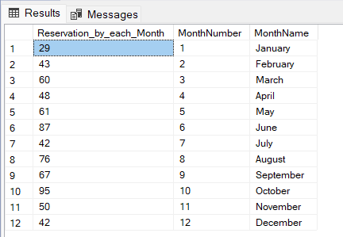
How many reservations were made in each month of the year?
SELECT COUNT(Booking_ID) AS Reservation_by_each_Month,
MONTH(arrival_date) AS MonthNumber,
DATENAME(MONTH, arrival_date) AS MonthName
FROM Hotel_Reservation
GROUP BY MONTH(arrival_date), DATENAME(MONTH, arrival_date)
ORDER BY MonthNumber;
QUERY - 12
Result
Insights: Analyzing reservations made in each month of the year reveals seasonal booking patterns, which can inform pricing strategies and marketing campaigns.

Slide 16
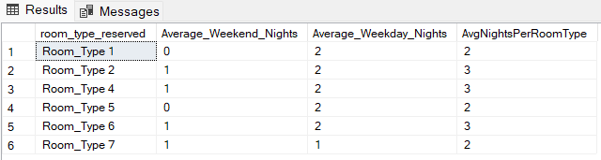
What is the average number of nights (both weekend and weekday) spent by guests for each room type?
SELECT room_type_reserved, AVG(no_of_weekend_nights) ASAverage_Weekend_Nights,
AVG(no_of_week_nights) AS Average_Weekday_Nights,
AVG(no_of_weekend_nights + no_of_week_nights) AS AvgNightsPerRoomType
FROM Hotel_Reservation
GROUP BY room_type_reserved;
QUERY - 13
Result
Insights: Understanding the average number of nights spent by guests for each room type helps in optimizing room inventory and pricing strategies.

Slide 17
For reservations involving children, what is the most common room type, and what is the average price for that room type?
SELECT TOP 1 room_type_reserved, AVG(avg_price_per_room) AS Average_Price
FROM Hotel_Reservation
WHERE no_of_children > 0
GROUP BY room_type_reserved
ORDER BY COUNT(room_type_reserved) DESC;
QUERY - 14
Result
Insights: Identifying the most common room type for reservations involving children helps the hotel allocate rooms effectively and potentially adjust room rates for family-friendly accommodations.

Slide 18

QUERY - 15
Find the market segment type that generates the highest average price per room.
SELECT TOP 1 market_segment_type, AVG(avg_price_per_room) AS AvgPricePerRoom
FROM Hotel_Reservation
GROUP BY market_segment_type
ORDER BY AvgPricePerRoom DESC;
Result
Insights: Finding the market segment type that generates the highest average price per room allows the hotel to focus on high-value customer segments and tailor services to meet their needs.

Slide 19

Empowering Insights, Limitless Possibilities
Unlock the potential of your hotel data to drive strategic decisions and elevate guest experiences.

Slide 20
THANK YOU

